Slide 1






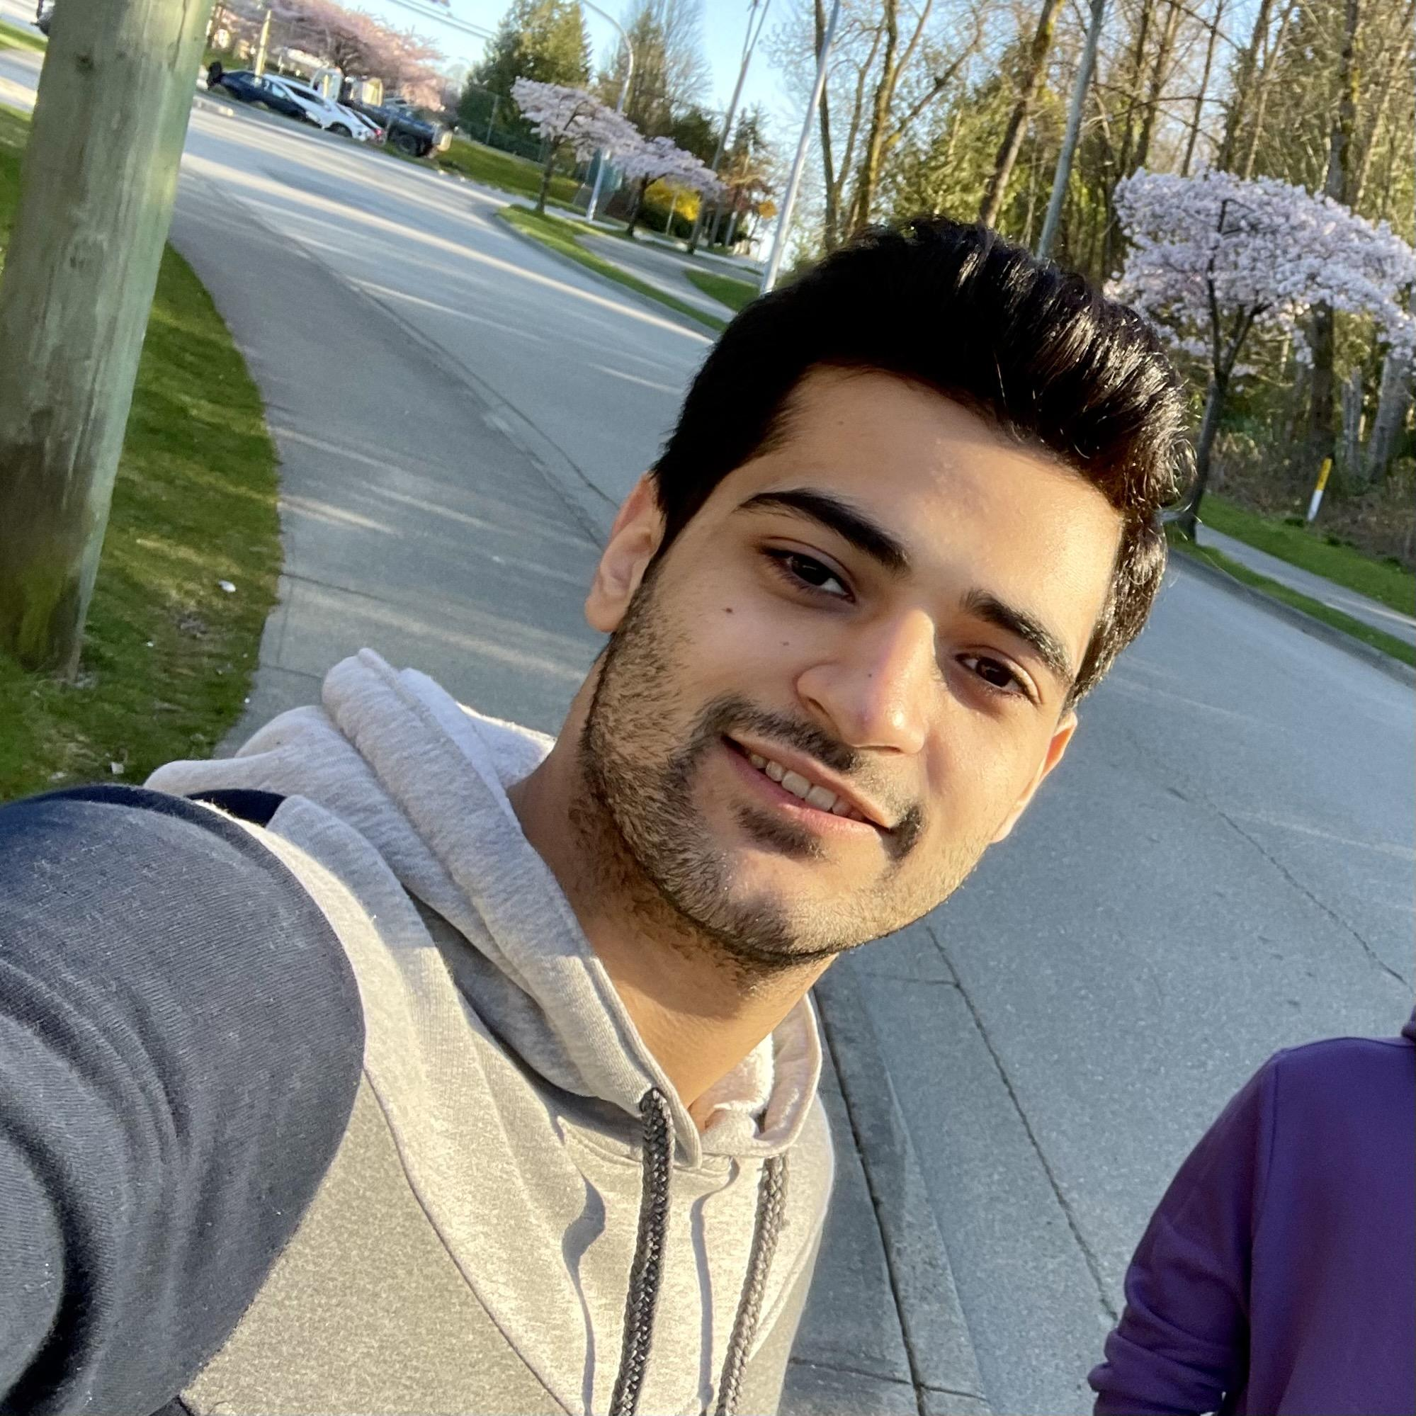
CMPT-985 Project: Team 5
Anchal Jain
Abhishek
SundarRaman
Cong Yuan
Gayatri Ganapathy
Mohammad
Ganji

Slide 2

Motivation
“Creativity is born out of necessity”
Lack of online platforms catering novice cooking learners.
Lack of personalized support in various cooking stages.
Need to learn self-cooking has risen during COVID-19.
Need for Smart features to reduce searching and learning time.

Slide 3



Tasks in the Proposed Design
Search Recipe
Live Learning
Smart Scan

Slide 4
Novel features of CulinaryHub
Filter recipes by scanning ingredient.
Suggest alternative ingredients
Hold Live 1:1 learning sessions with an expert chef
Smart Scan to capture the freshness and nutritional value of food items

Slide 5
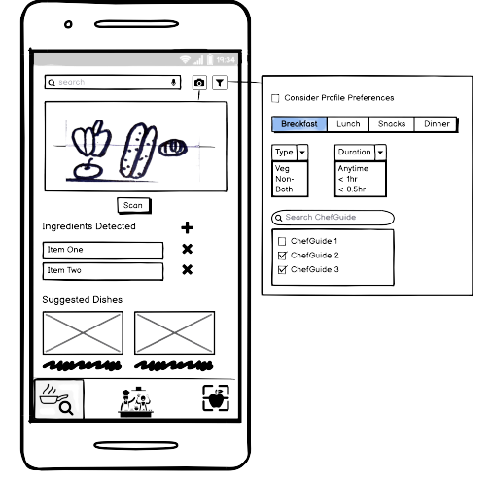
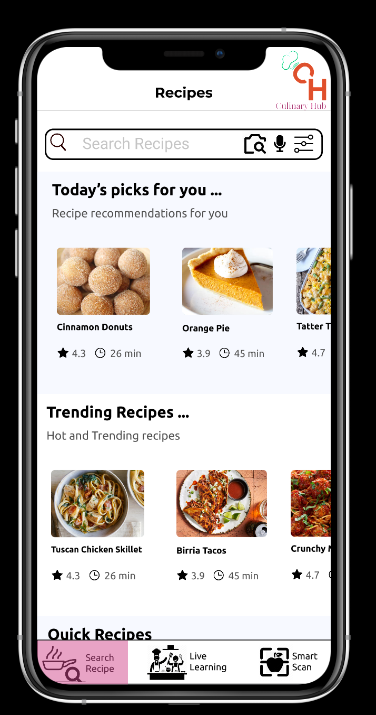
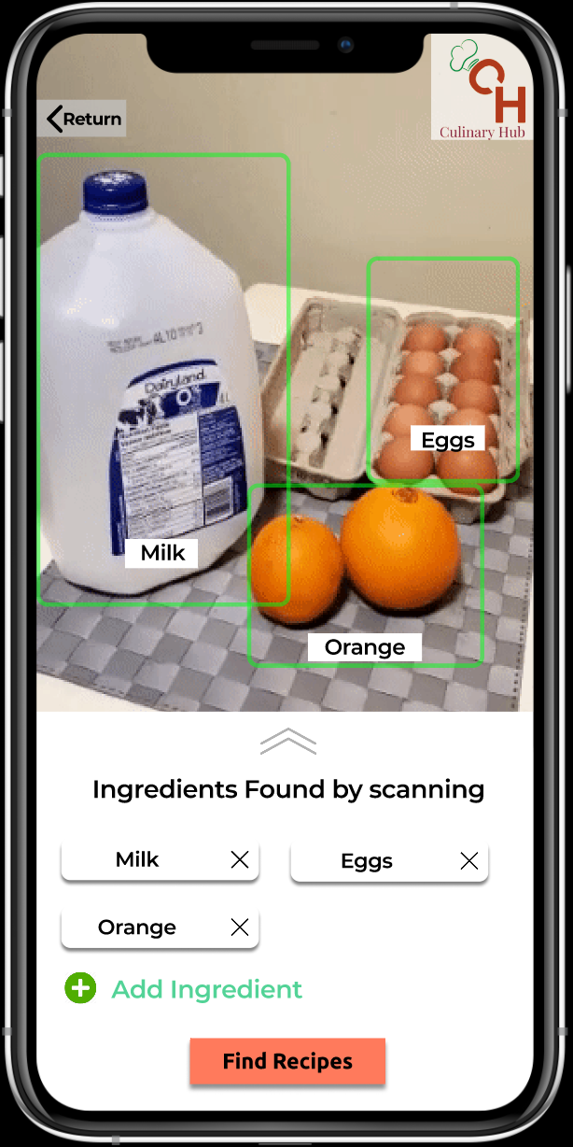
Evolution of Task 1
Features:
Filters to suit user preferences.
Ingredient scanner to reduce search time
Shows the Trending dishes accordingly

Slide 6
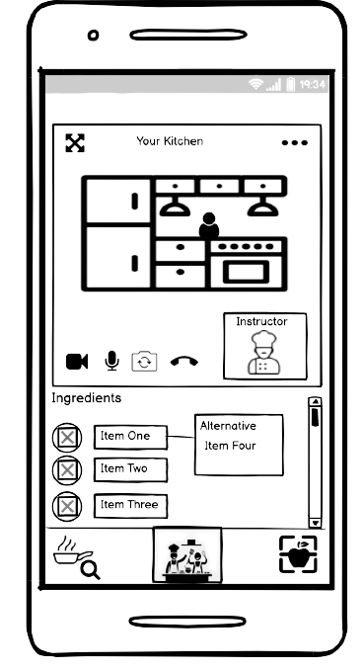
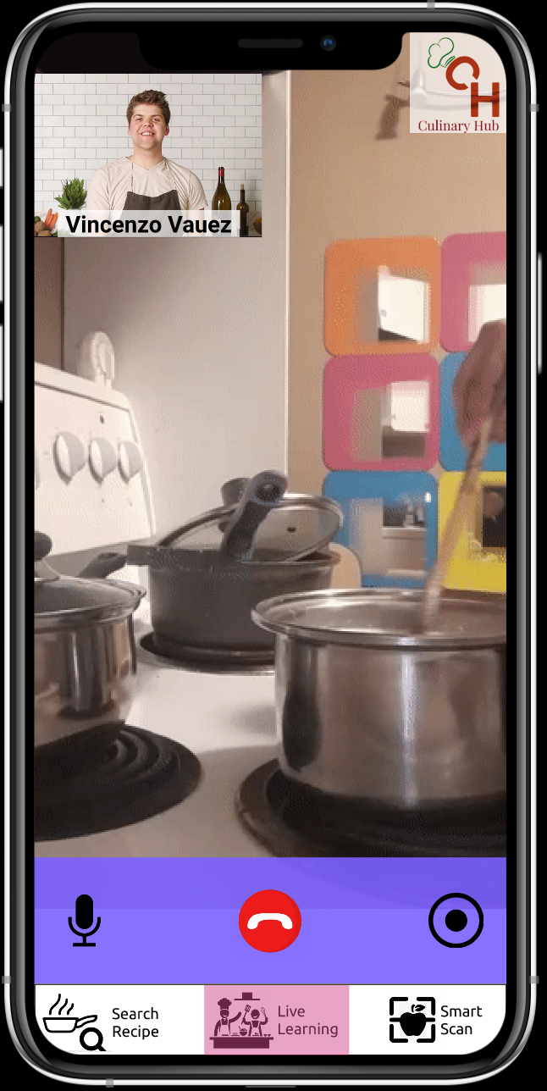
Evolution of Task 2
Features:
Live learning session with an expert chef for a particular recipe.
Suggestion of alternative ingredients for a recipe.

Slide 7
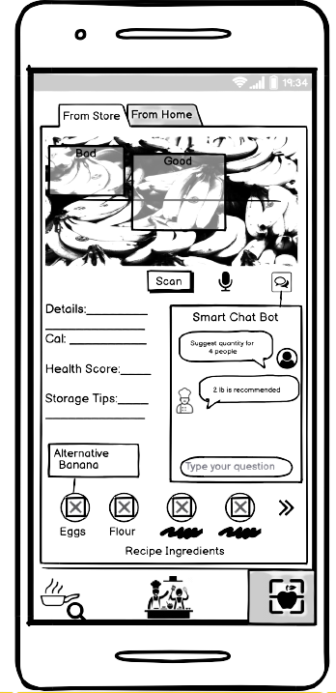
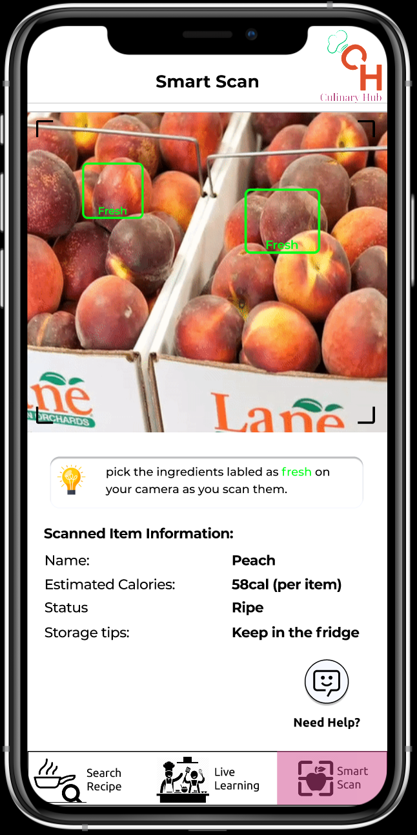
Evolution of Task 3
Features:
Scan ingredients available at Home/Store for a selected recipe.
Display nutritional value of scanned items.
Suggests alternative ingredients.
Typing/voice enabled Smart Chat Bot support

Slide 8


High Fidelity Prototype Walkthrough
Using
If there are any issues in playing the video, click on this YouTube link

